Slide 1
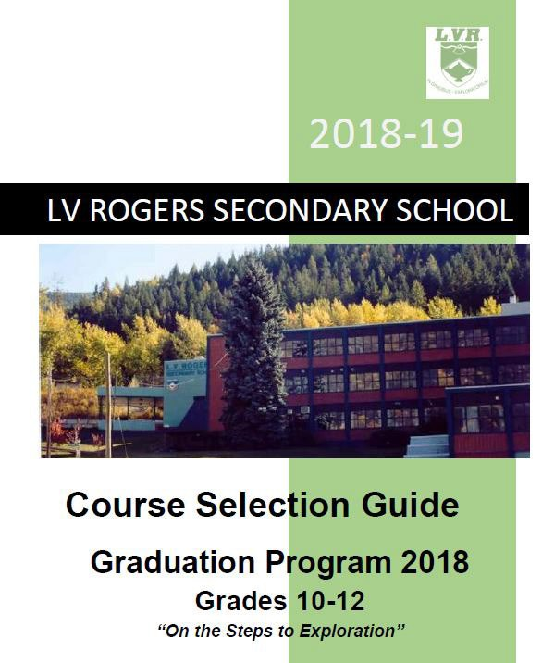
2024-25

Slide 2
https://lvr.sd8.bc.ca/ https://lvr.sd8.bc.ca/node/37657
Course selection forms and information for the 2024-25 School Year.
Please note that our timetable & the courses that we will run in 2024-25 depend completely on students' course selections!
After our timetable is built over the coming months, we cannot guarantee changes to students' schedules.
BC Graduation Program
BC Curriculum
SD8 Year Graduation Plan Student Form
Parent Night Information Flyer
Course Selection Presentation for Grade 10 in 2024/25
Course Selection Presentation for Grade 11/12 in 2024-25
Grade 10 Course Selection Form
Grade 10 Course Code Sheet - in development for 2024/25
Grade 11 Course Selection Form
Grade 11 Course Code Sheet - in development for 2024/25
Grade 12 Course Selection Form
Grade 12 Course Code Sheet - in development for 2024/25
ESN Course Descriptions 23/24 for CSF Students

Slide 3
What do I need to graduate in 2025 or 2026?
A three-year program starting in Grade 10, and concluding in Grade 12
A combination of Required/Core Courses, Electives, Career Education, and Capstone Project)
You need 80 credits to graduate—at a MINIMUM!
Important to look at required courses & grades for beyond graduation!

Slide 4
Trades?
Arts?
Sciences?
Fine Arts?

Slide 5
Requirements Beyond Grade 10
All grade 11 students must take at least one :
Social Studies 11 or 12
Math 11
Science 11
English 11
All grade 12 students must take :
English 12
Career Life Connections and Capstone

Slide 6
BC Ministry Indigenous Graduation Requirement
As of September 2023, Students must take at least ONE of the offered BC Indigenous Courses to graduate.
At LVR, students will be enrolled in First Peoples English 10 to satisfy this requirement.
Grad 2025 students will need to take BC First Peoples 12 to meet this requirement, which will also meet the Social Studies 11/12 grad requirement.
BC First Peoples 12 will continue to be offered as a Social Studies 11/12 credit or elective credit, along with other possible Social Studies 11/12 courses

Slide 7
DANCE 10: GENERAL
DANCE 10: PERFORMANCE
DRAMA 10: GENERAL
FOODS AND NUTRITION 10
INFORMATION TECHNOLOGY 10
MUSIC 10: CONCERT BAND
MUSIC 10: GUITAR
MUSIC 10: JAZZ BAND
TECHNOLOGY EDUC 10: DRAFTING•
AUTOMOTIVE TECHNOLOGY 11
CAFETERIA TRAINING 11
CARPENTRY & JOINERY 11
DANCE: PERFORMANCE 11
DRAFTING & DESIGN 11
FOODS AND NUTRITION 11
ICT: COMPUTER INFORMATION SYSTEMS 11
INDUSTRIAL DESIGN 11
INSTRUMENTAL MUSIC 11: CONCERT BAND
INSTRUMENTAL MUSIC 11: GUITAR
INSTRUMENTAL MUSIC 11: JAZZ BAND
METAL FABRICATION AND MACHINING 11
MUSIC: COMPOSITION & TECHNOLOGY 11
STUDIO ARTS 11: CERAMICS AND SCULPTURE
TEXTILES 11
THEATRE PERFORMANCE 11: ACTING
VISUAL ARTS: MEDIA ARTS 11
CAFETERIA TRAINING 12
CARPENTRY & JOINERY 12
DANCE: PERFORMANCE 12
DRAFTING & DESIGN 12
FOODS AND NUTRITION 12
ICT: COMPUTER INFORMATION SYSTEMS 12
INSTRUMENTAL MUSIC 12: CONCERT BAND
INSTRUMENTAL MUSIC 12: GUITAR
INSTRUMENTAL MUSIC 12: JAZZ BAND
MUSIC: COMPOSITION & TECHNOLOGY 12
STUDIO ARTS 12: CERAMICS AND SCULPTURE
TEXTILES 12
THEATRE PERFORMANCE 12: ACTING
VISUAL ARTS: MEDIA ARTS 12
WORK EXPERIENCE 12A
WORK EXPERIENCE 12B
AND DESIGN
TECHNOLOGY EDUCATION 10:GENERAL
TECHNOLOGY EDUCATION 10:MECHANICS
TECHNOLOGY EDUCATION 10:METALWORK
TECHNOLOGY EDUCATION 10:WOODWORK
TEXTILES 10
VISUAL ARTS 10: GENERAL
VISUAL ARTS 10: MEDIA ARTS
ART FOUNDATIONS 12
AUTOMOTIVE TECHNOLOGY 12
ART FOUNDATIONS 11

Slide 9
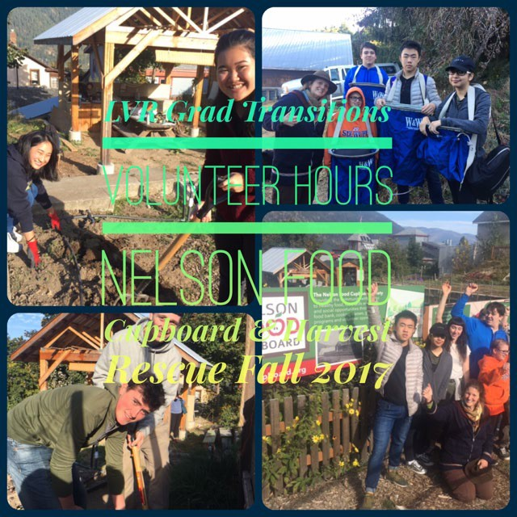
Scholarship Ready.
Post-Sec Ready.

Slide 12
English Pathways
Grade 10: First People’s English 10
(Literary Studies and Writing 10)
Grade 11:
Literary Studies 11
Composition 11
AP Language & Composition 11
Grade 12:
English Studies 12
AP Literature & Composition 12

Slide 15
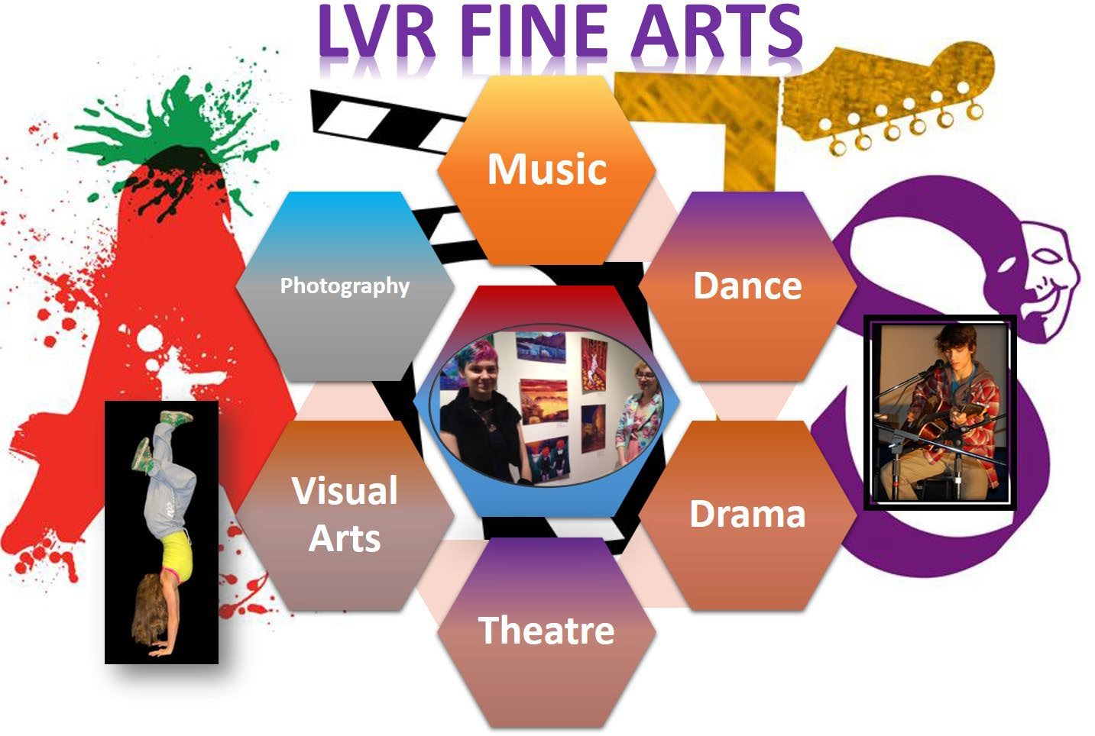

Slide 16
Music – scheduling details in development
Dance – scheduling details in development
Band 10
Band 11/12
Jazz Band 10-12 outside the timetable
Beginner Guitar, Intermediate Guitar
Dance Academy (full year, two courses) inside the timetable
Dance Academy outside the timetable
Drama - scheduling details in development
Visual Arts
Art Studio
Ceramics
Photography
Drama 10-12 inside the timetable
Theatre Production outside the timetable

Slide 18
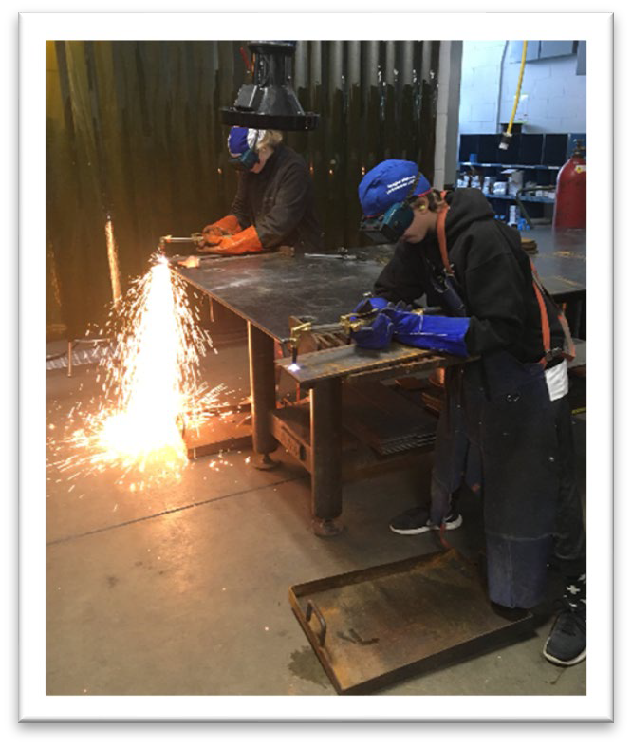

Slide 20
Applied Skills
Art Metal Jewelry
Computer Programming & Game Design
Drafting & Design
Food Studies
LVTV (outside the timetable)
Media Arts & Design
Metalwork
Power Technology (Auto Shop)
Textiles
Woodwork

Slide 21
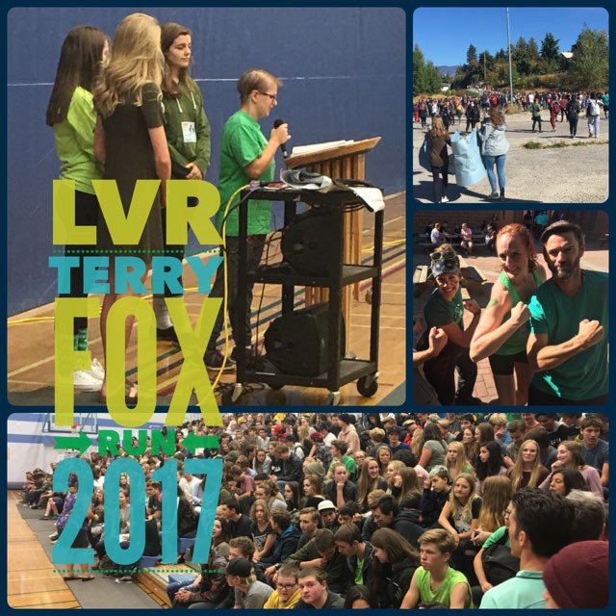
Physical Education and Leadership
Active Living 11/12
Basketball 11/12
Mountain Biking 10-12
Recreational Leadership 11/12
Strength and Conditioning 11/12
Volleyball 11/12

Slide 22
Modern Languages
Core French
Level 1
Level 1
Spanish
Level 1
Level 2

Slide 24
Electives: Choose wisely!
There are many electives to choose from at LVR
Don’t choose an elective based on what your friends are doing
Don’t forget about electives outside the timetable

Slide 25
What about Graduation Assessments?
Literacy 10
Numeracy 10
Literacy 12
All students need these three assessments
for Graduation, but they won’t count as a course mark.
These assessments will be marked on a 4 point scale.
You have up to three times to take the Assessments, if you choose to.

Slide 29
Thank you!
Principal Dan Rude
dan.rude@sd8.bc.ca
Vice-Principal Roman Wylli3
roman.wyllie@sd8.bc.ca
Counsellor Shelley Wiltshire(A-L)
shelley.wiltshire@sd8.bc.ca
Counsellor Karl Machado (M-Z)
karl.machado@sd8.bc.ca
https://lvr.sd8.bc.ca/

