Slide 1

LV Rogers Course Selection Presentation
2026 - 2027 Grade 9 going into Grade 10

Slide 2

Land Acknowledgement
I gratefully acknowledge, respect and honour the First Nations in whose traditional territories the Kootenay Lake School District operates and all Aboriginal people residing within the boundaries of School District #8.

Slide 3
Required Courses for Grade 10 – English Program
All Grade 10 English students will be pre-enrolled in the following 5 core courses:
English 10
Physical and Health Education 10
Career Life Education10
Science 10
Social Studies 10

Slide 4
Required Courses for Grade 10 French Immersion Program
All Grade 10 French Immersion students will be pre-enrolled in the following 3 French Immersion courses:
Français Langue Seconde Immersion 10
Sciences Humaines 10
Education Au Choix De Carriere Et De Vie 10
French Immersion students will also be pre-enrolled in the following English stream courses:
PHE 10
English 10
Science 10

Slide 5
Grade 10 Math: A tale of two courses
1. Foundations & Pre-calculus Math 10 2. Workplace Math 10
Neither option closes doors — the right choice is the one where a student can be successful and confident.

Slide 6
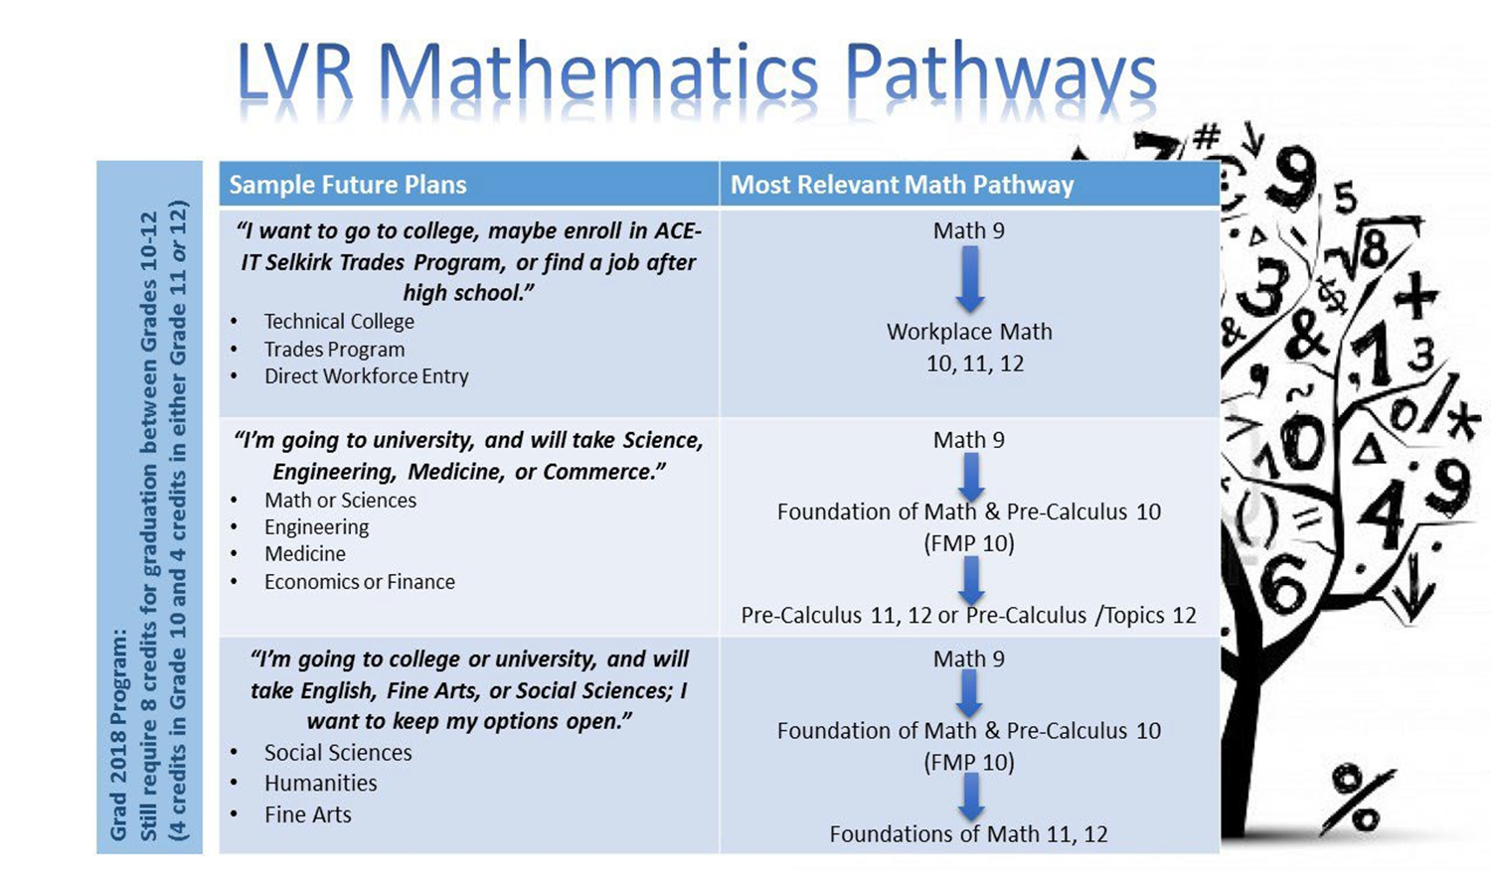

Slide 7
Grade 10 Electives: A tale of two options
There are many electives to choose from at LV. Students in Grade 10 pick 2 in the timetable but have off-timetable options as well.
Electives are often where students discover strengths they didn’t know they had.

Slide 8

Fine Arts
Visual Arts
Art Studio
Ceramics
Photography
Drama
Drama inside the timetable
Theatre Production outside the timetable

Slide 9
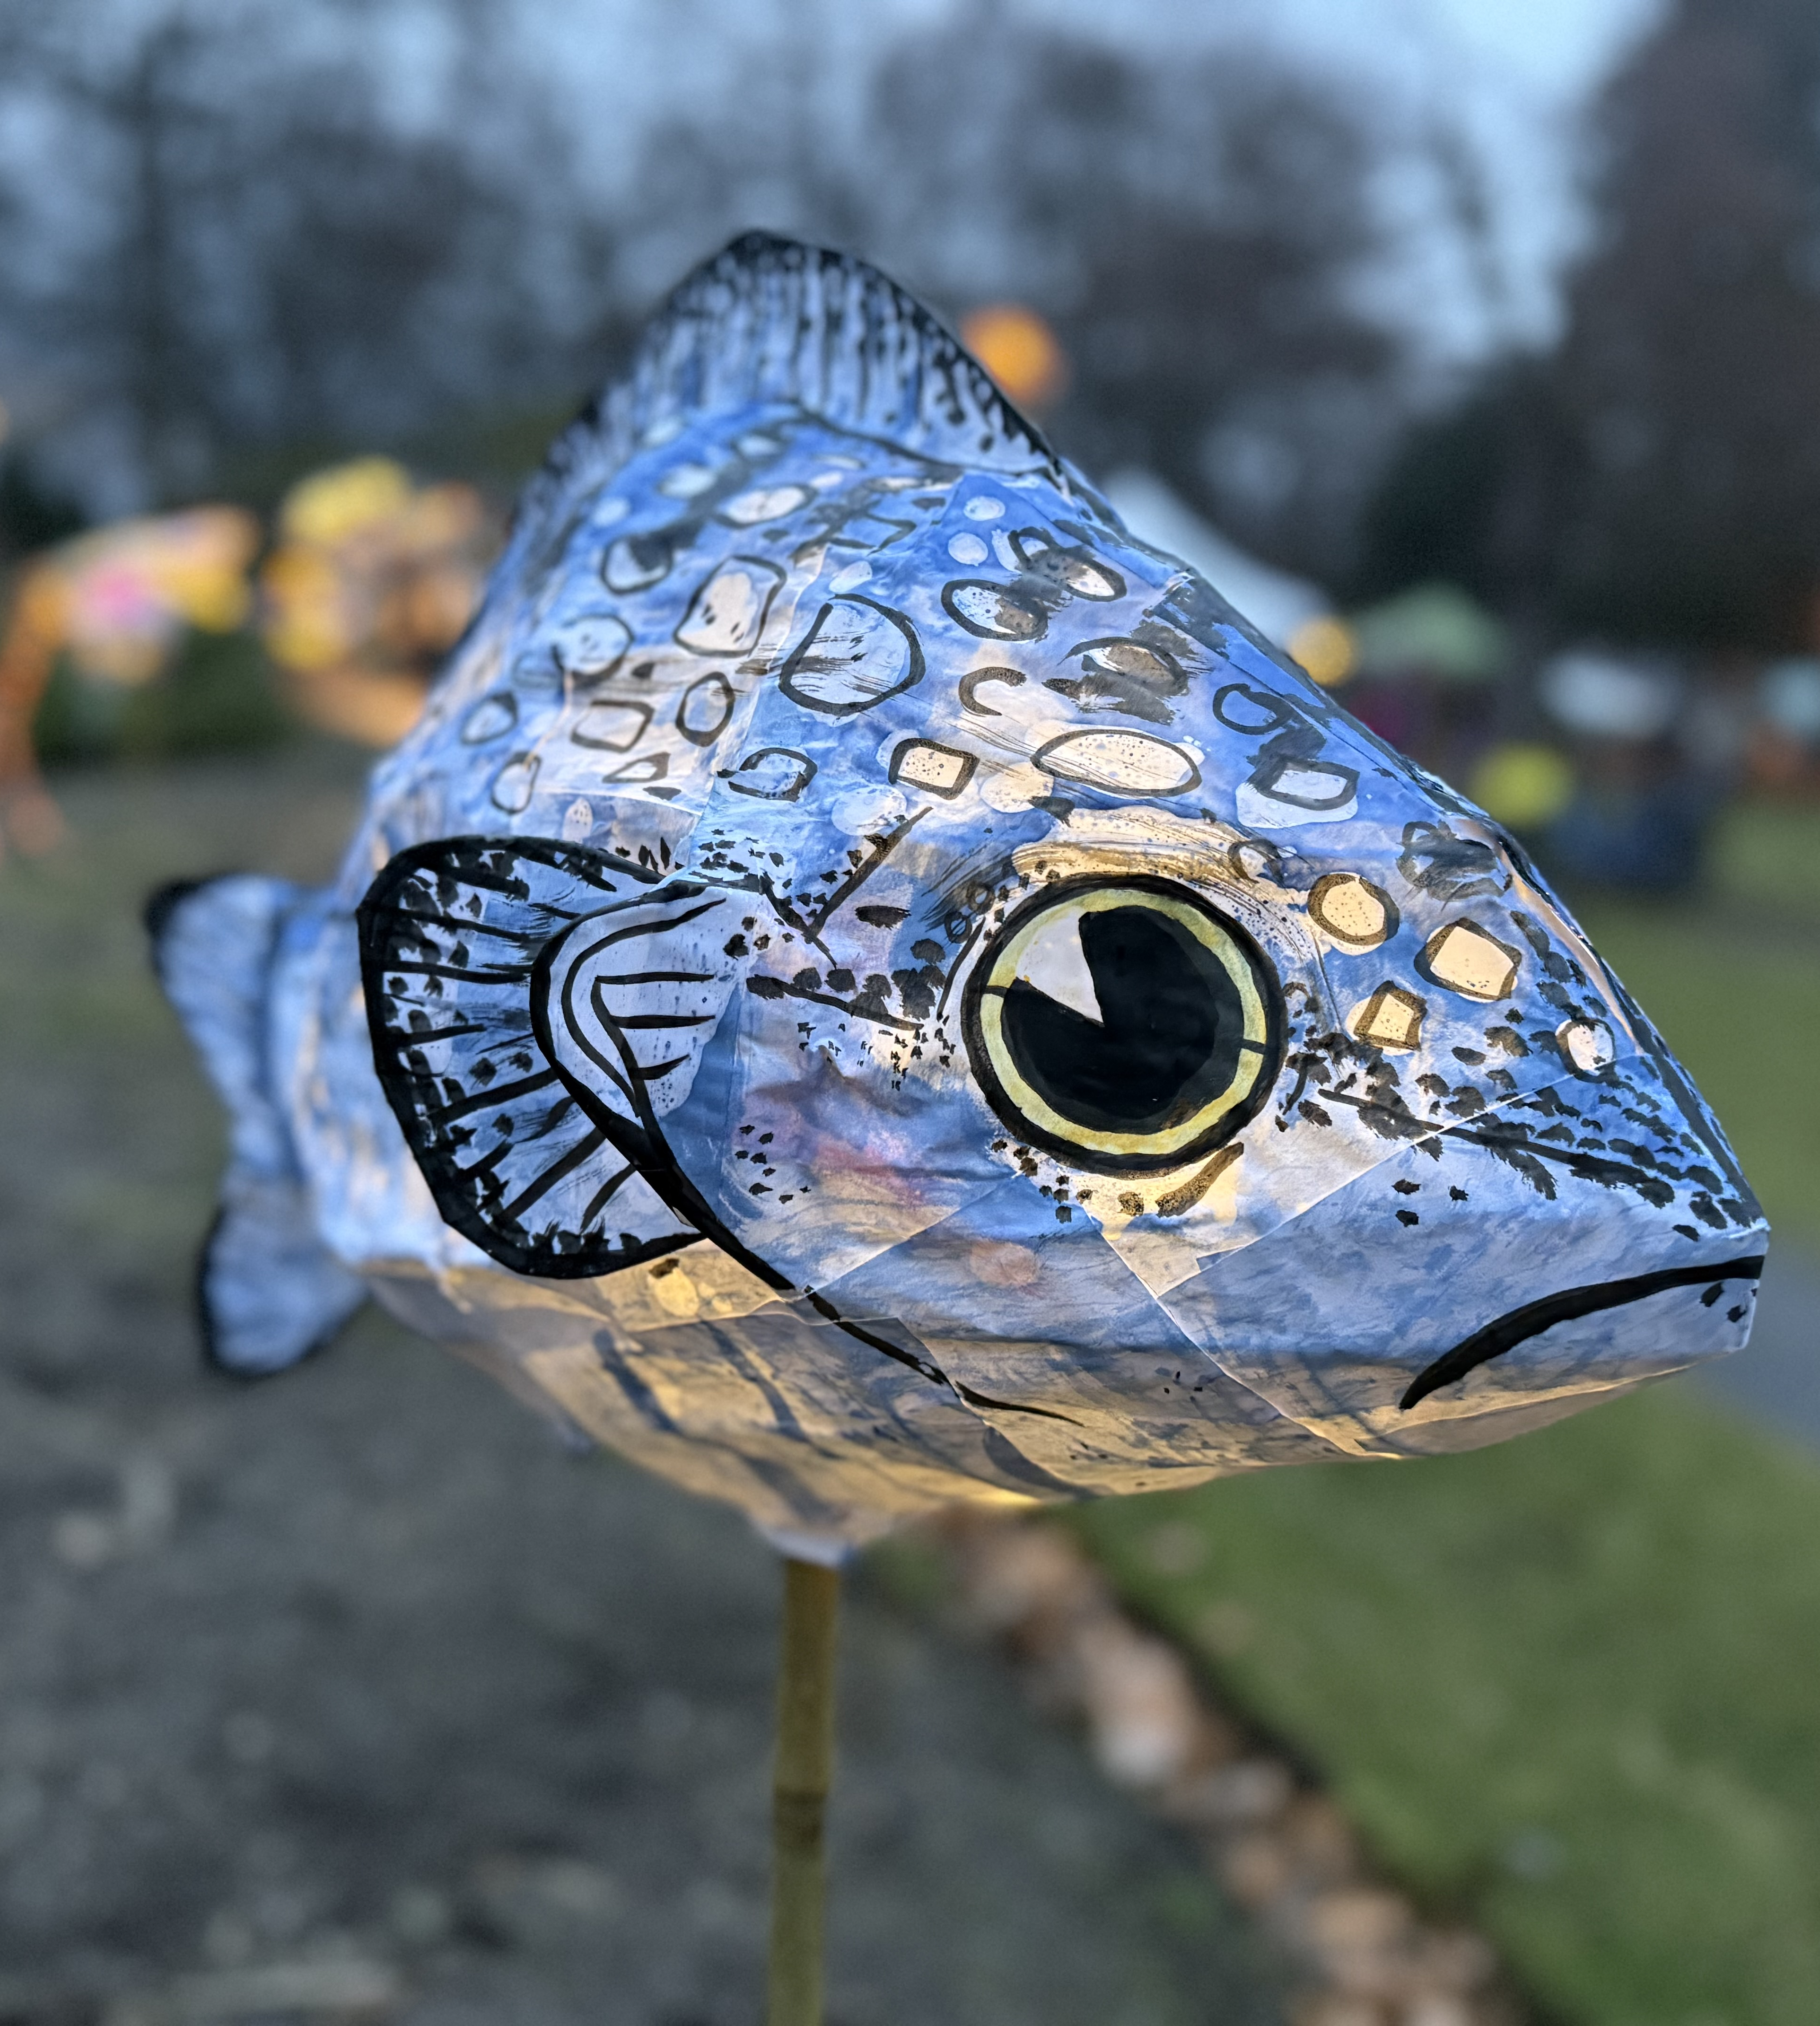
Even more Fine Arts
Music
Concert Band inside the timetable
Jazz Band outside the timetable
Guitar inside the timetable
Dance
Dance Academy (full year, two courses) inside the timetable
Dance Company (full year, one course) outside the timetable
Dance Foundations (One semester, one course) inside the timetable
Notes:
If jazz band, then sign up for in timetable Concert band as well. Possible Jr. and Sr. Bands as well depending on numbers

Slide 10
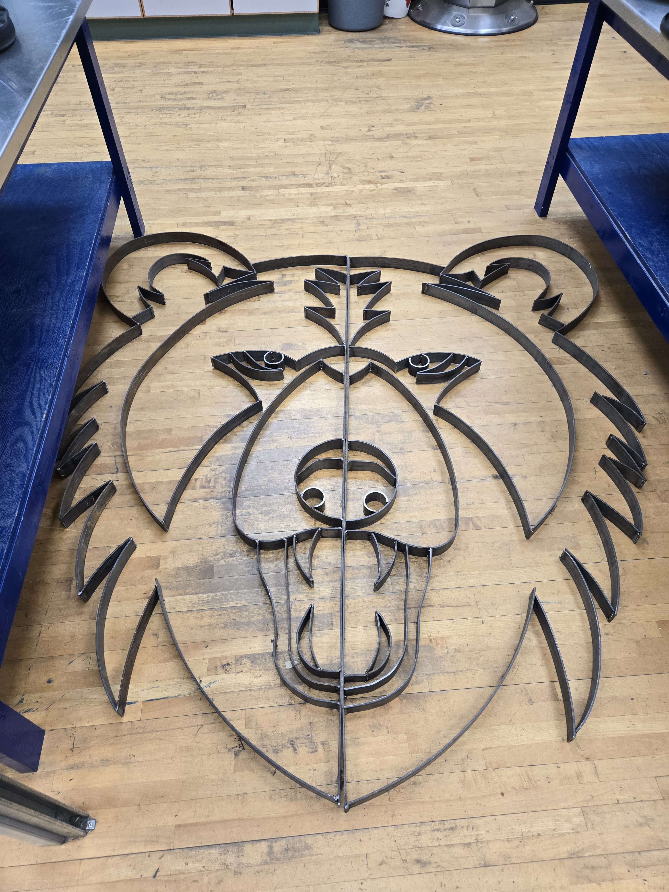
ADST
Art Metal Jewelry
Drafting
Food Studies
Media Arts & Design
Metalwork
Mountain Biking
Power Technology (Auto Shop)
Textiles
Woodwork

Slide 11
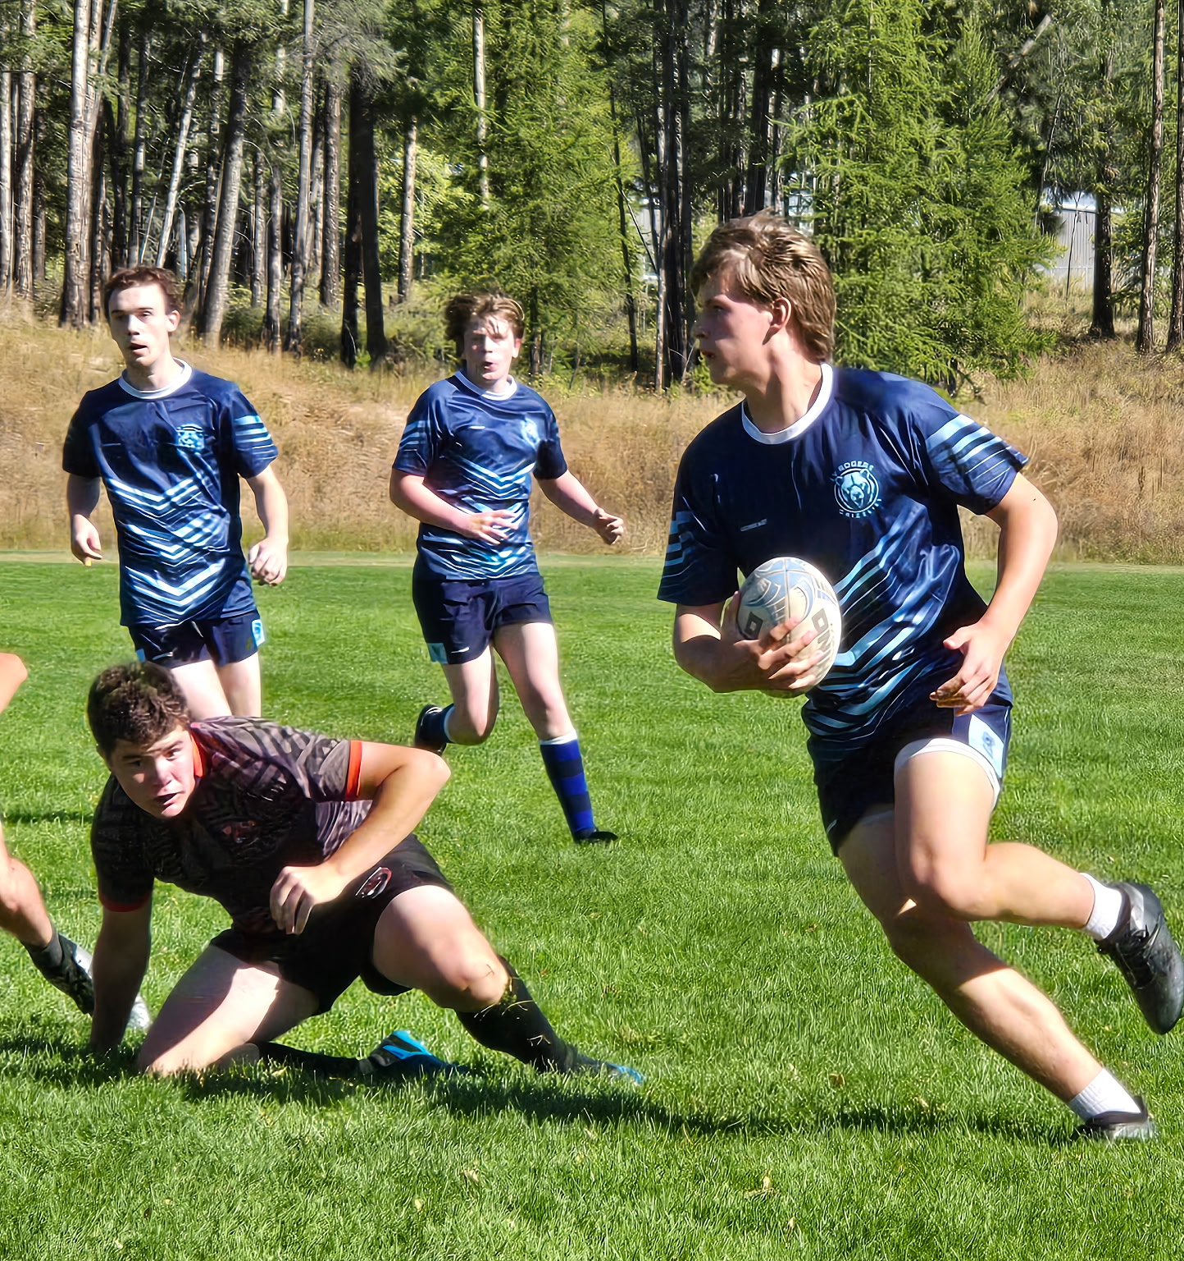
Clubs, Teams, and all the other good stuff
https://lvr.sd8.bc.ca/programs/athletics/lvr
AP classes, Academies, Athletics, Green Team, Clubs, etc. etc.,
High school at LV is all about finding your passion and putting yourself out there.

Slide 12
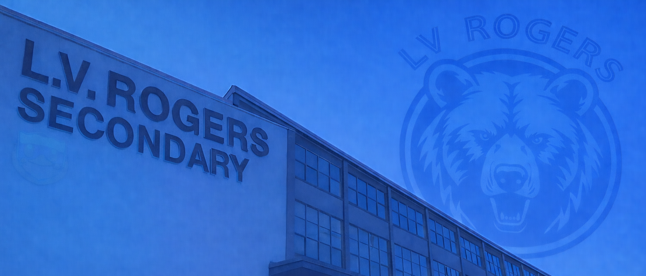
Course Selection
What do I actually have to do?

Slide 13
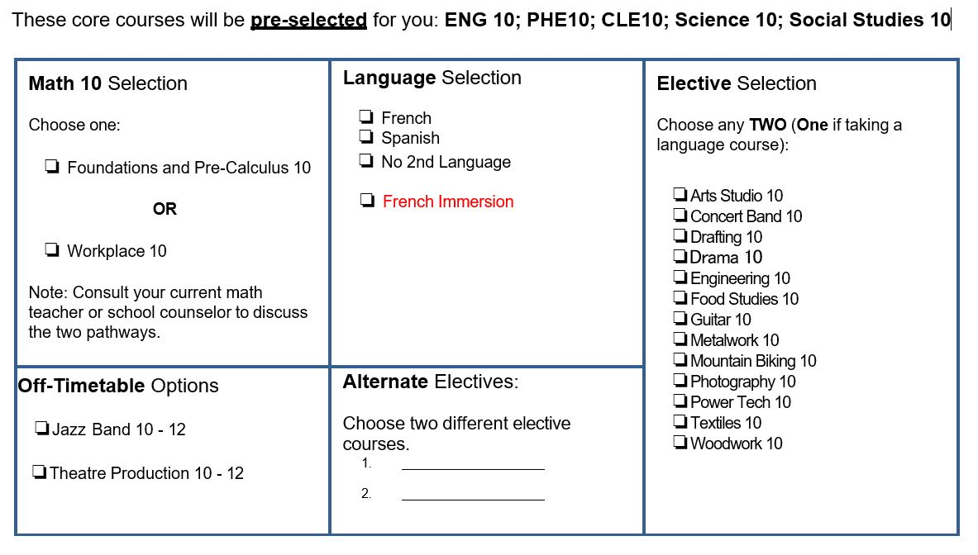

Slide 14
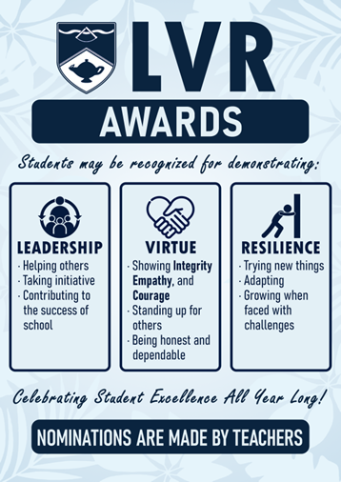
Awards and Recognitions
At LV Rogers, we celebrate achievement, but we also recognize contribution, character, and growth.
The L.V.R. Awards recognize students who contribute to our school community through their Leadership, Virtue (Integrity, Empathy and Courage), or Resilience. The LVR Awards are nominated by staff and handed out at the end of each semester.
Academic Honour Roll celebrates Grade 10 students with 8 classes scheduled at LVR and who achieve an average of 86% and above for the school year. Academic Honour roll is awarded at the end of the school year.

Slide 15
Final words of advice
Don’t just choose what feels easiest, choose what helps you grow.
Try something new, commit to the work, and stay with challenges when they get hard.
Those are the experiences that shape who you will become. They are what will help you make the most of your time at LVR

Slide 16
Where can I find more information?
LVR homepage LVR Course selection
3 year grad plan
Post-Secondary Planner

Slide 17
Questions? Thank you!
Ian Cooper - Principal
ian.cooper@sd8.bc.ca LVR Weekly Blog https://lvr.sd8.bc.ca/blog
Roman Wyllie – Vice Principal
roman.wyllie@sd8.bc.ca
Cara McGuire – Gr. 10 - 11 Counselor cara.mcguire@sd8.bc.ca

