Slide 1

LV Rogers
Course Selection Presentation
2026 - 2027
Grade 10 going into Grade 11

Slide 2
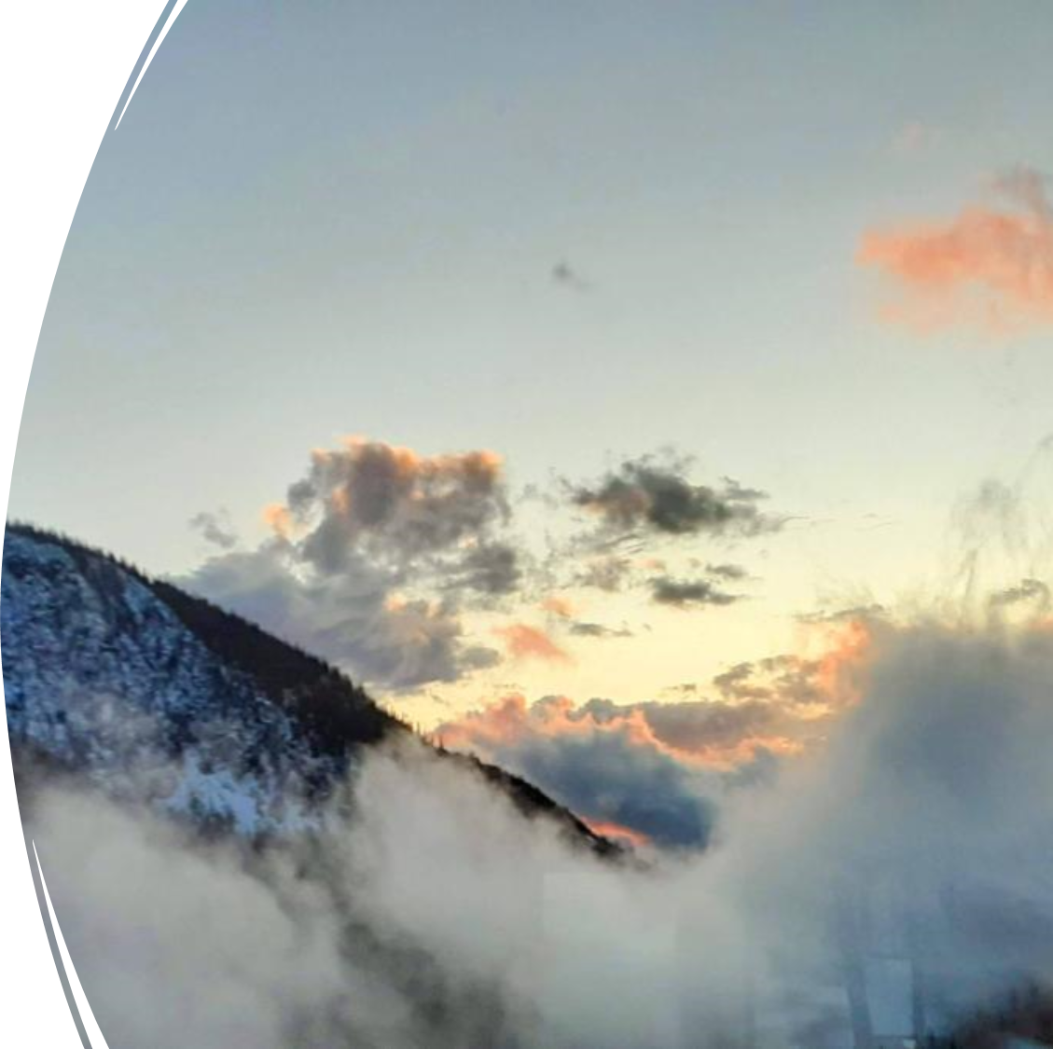
Land Acknowledgement
I gratefully acknowledge, respect and honour the First Nations in whose traditional territories the Kootenay Lake School District operates and all Aboriginal people residing within the boundaries of School District #8.

Slide 3
Required Courses for Grade 11 – English Program
All Grade 11 students must complete the following courses prior to graduation.
At least one English 11 Course
At least one Science 11 or 12 Course
At least one Social Studies 11 or 12 class – More on this later!
Students need 80 credits to graduate, but most choose to take more
Electives and at least one indigenous-focused course

Slide 4
Required Courses for Grade 11
French Immersion Program
All Grade 11 French Immersion students will be pre-enrolled in the following 2 French Immersion courses:
Communication Orale 11
Exploration en Sciences Humaines 11

Slide 5
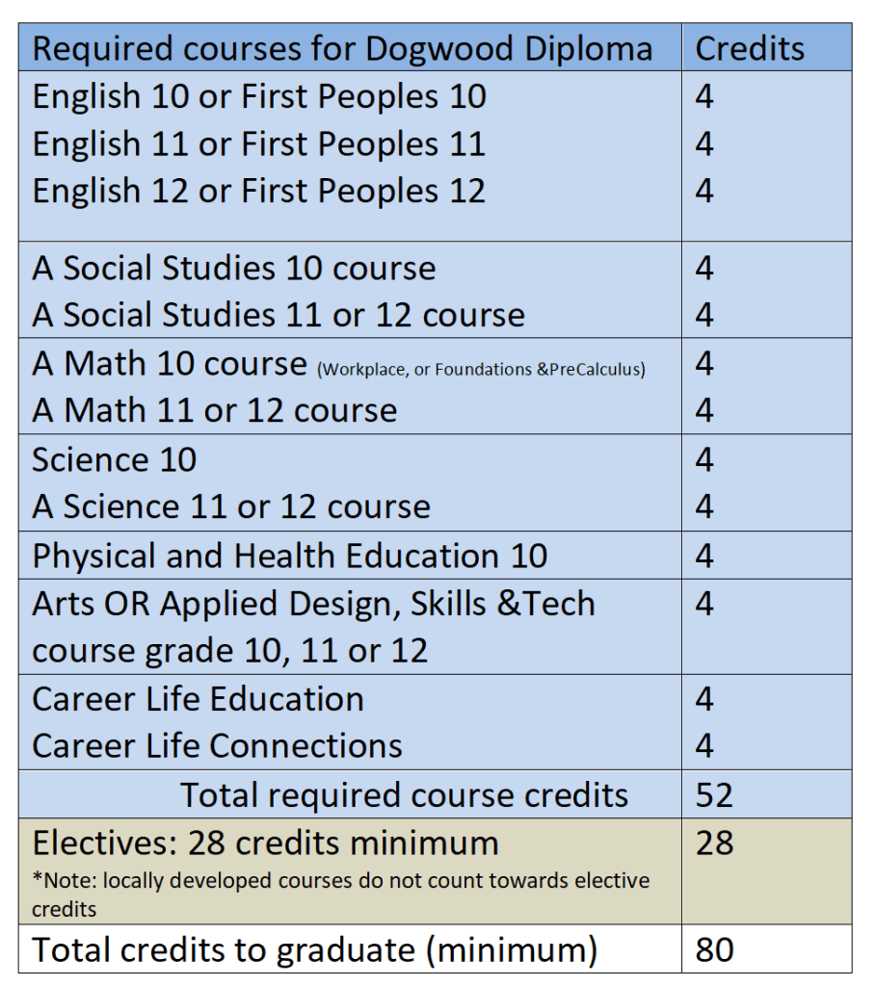
Requirements for Graduation
Important notes about credits:
Of the 80 credits required to graduate, a minimum of 16 credits must be for courses at the Grade 12 level (generally 4 courses)
At least 4 credits must be from Indigenous-focused course work.
In addition to the 80 credits students must complete three Provincial Assessments:
· Literacy 10
· Numeracy 10
· Literacy 12

Slide 6
Grade 11 Math -
All about options
Pre-Calculus 11
Foundations & Pre-calculus Math 11
Workplace Math 11
No option closes doors — the right choice is the one where a student can be successful and confident.

Slide 7
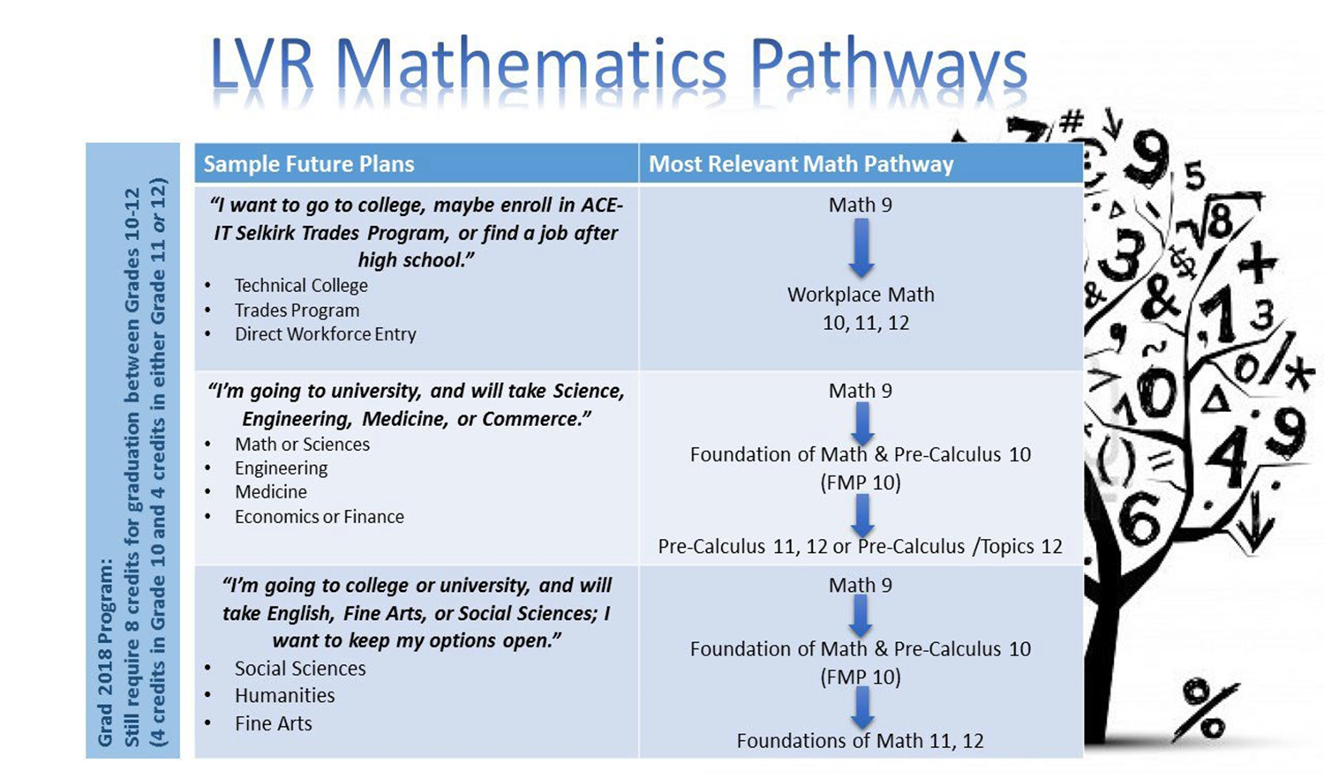

Slide 8
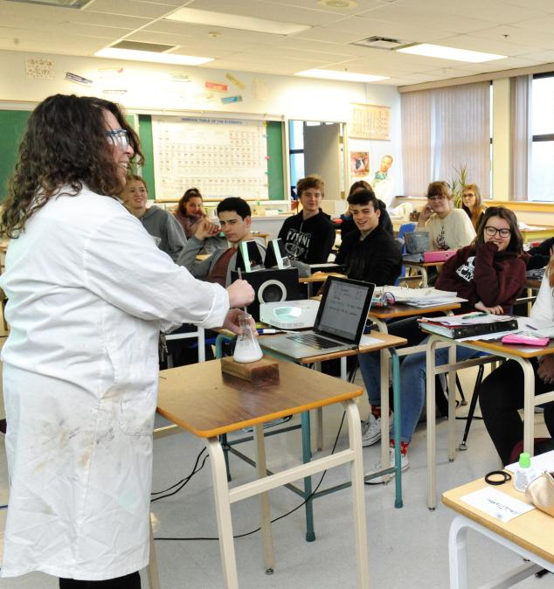
Grade 11 Science -
Discover your interests
Chemistry 11
Earth Science 11
Physics 11
Life Sciences 11

Slide 9
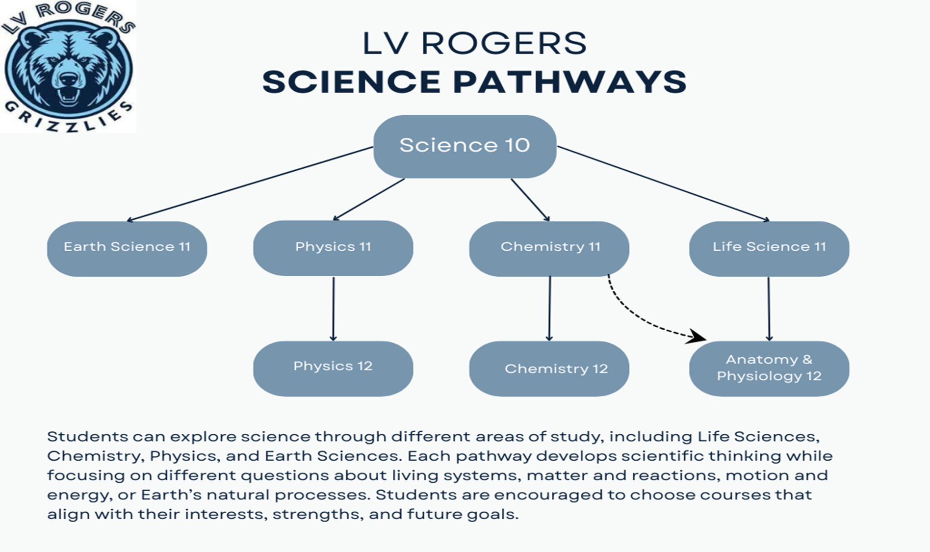

Slide 10
Grade 11 Social Studies options
Students should take Exploration in Socials 11 to learn how Canada developed to this day and gain a better understanding of our national and international relationships. This is a foundational course to build students’ skills in Social Studies.
Students can also take Law 12, BC First Peoples 12, Human Geography 12, or Comparative Cultures 12. These will go more in depth into the current social and political landscape. Students should expect a high degree of rigor as can be expected of Grade 12 coursework.

Slide 11
Grade 11 English options
New for this year is Composition11. Composition 11 provides opportunities for students to study, create, and write original and authentic pieces for a range of purposes and real-world audiences.
Students may also select Literary Studies 11, AP 11 Language and Composition.
Students can also still take Creative Writing 12 as an elective course to expand their writing repertoire. However, this course would be in addition to English 11, not in place of that coursework.

Slide 12
Grade 11 Electives:
Students in Grade 11 can fill their schedules (after their required courses) with so many options.
This could be anything from additional science courses, Drama, Dance, or many others
Electives are often where students discover strengths they didn’t know they had.

Slide 13

Fine Arts
Visual Arts
Art Studio
Ceramics
Photography
Drama
Drama
inside the timetable
Theatre Production outside the timetable

Slide 14
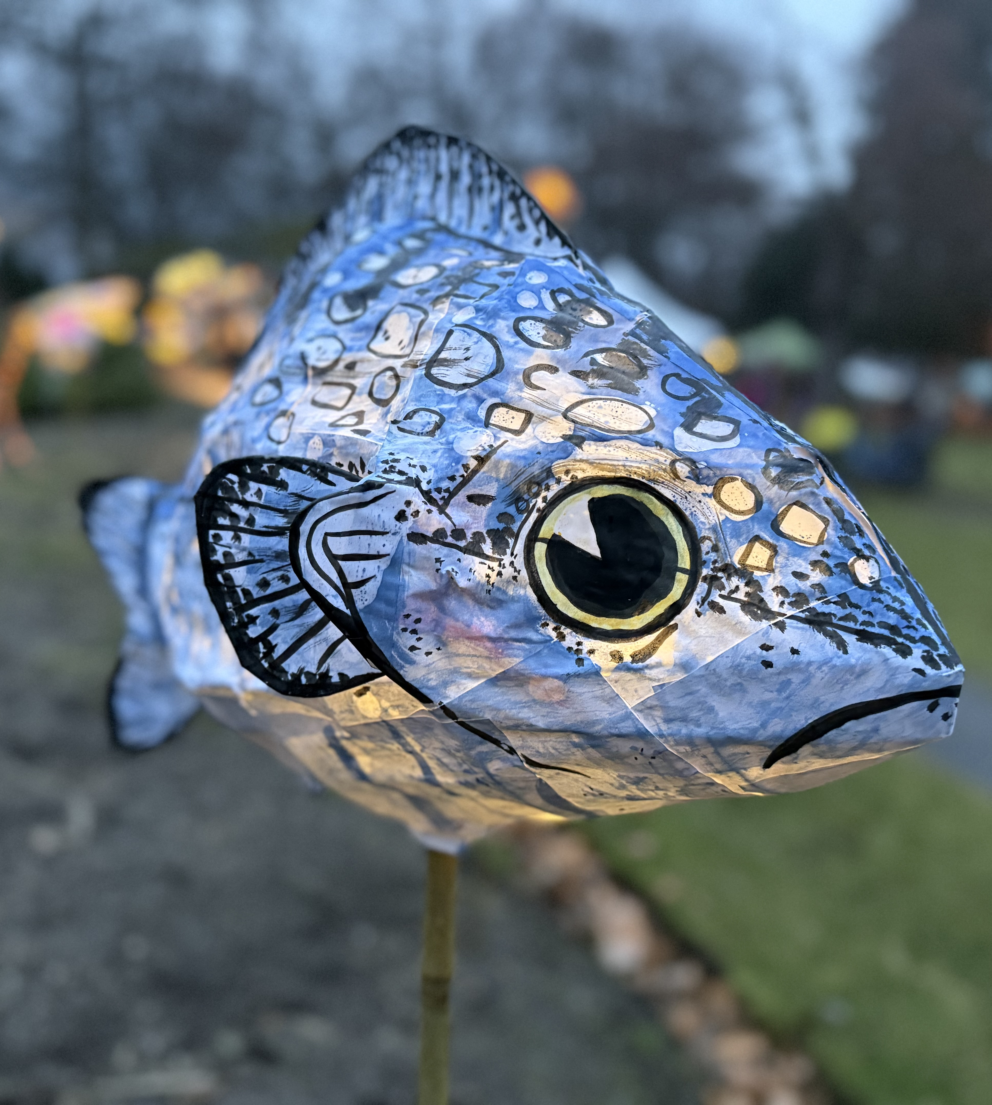
Even more Fine Arts
Music
Concert Band inside the timetable
Jazz Band outside the timetable
Guitar inside the timetable
Dance
Dance Academy (full year, two courses) inside the timetable
Dance Company (full year, one course) outside the timetable
Dance Foundations (One semester, one course) inside the timetable
Notes:
If jazz band, then sign up for in timetable Concert band as well. Possible Jr. and Sr. Bands as well depending on numbers

Slide 15
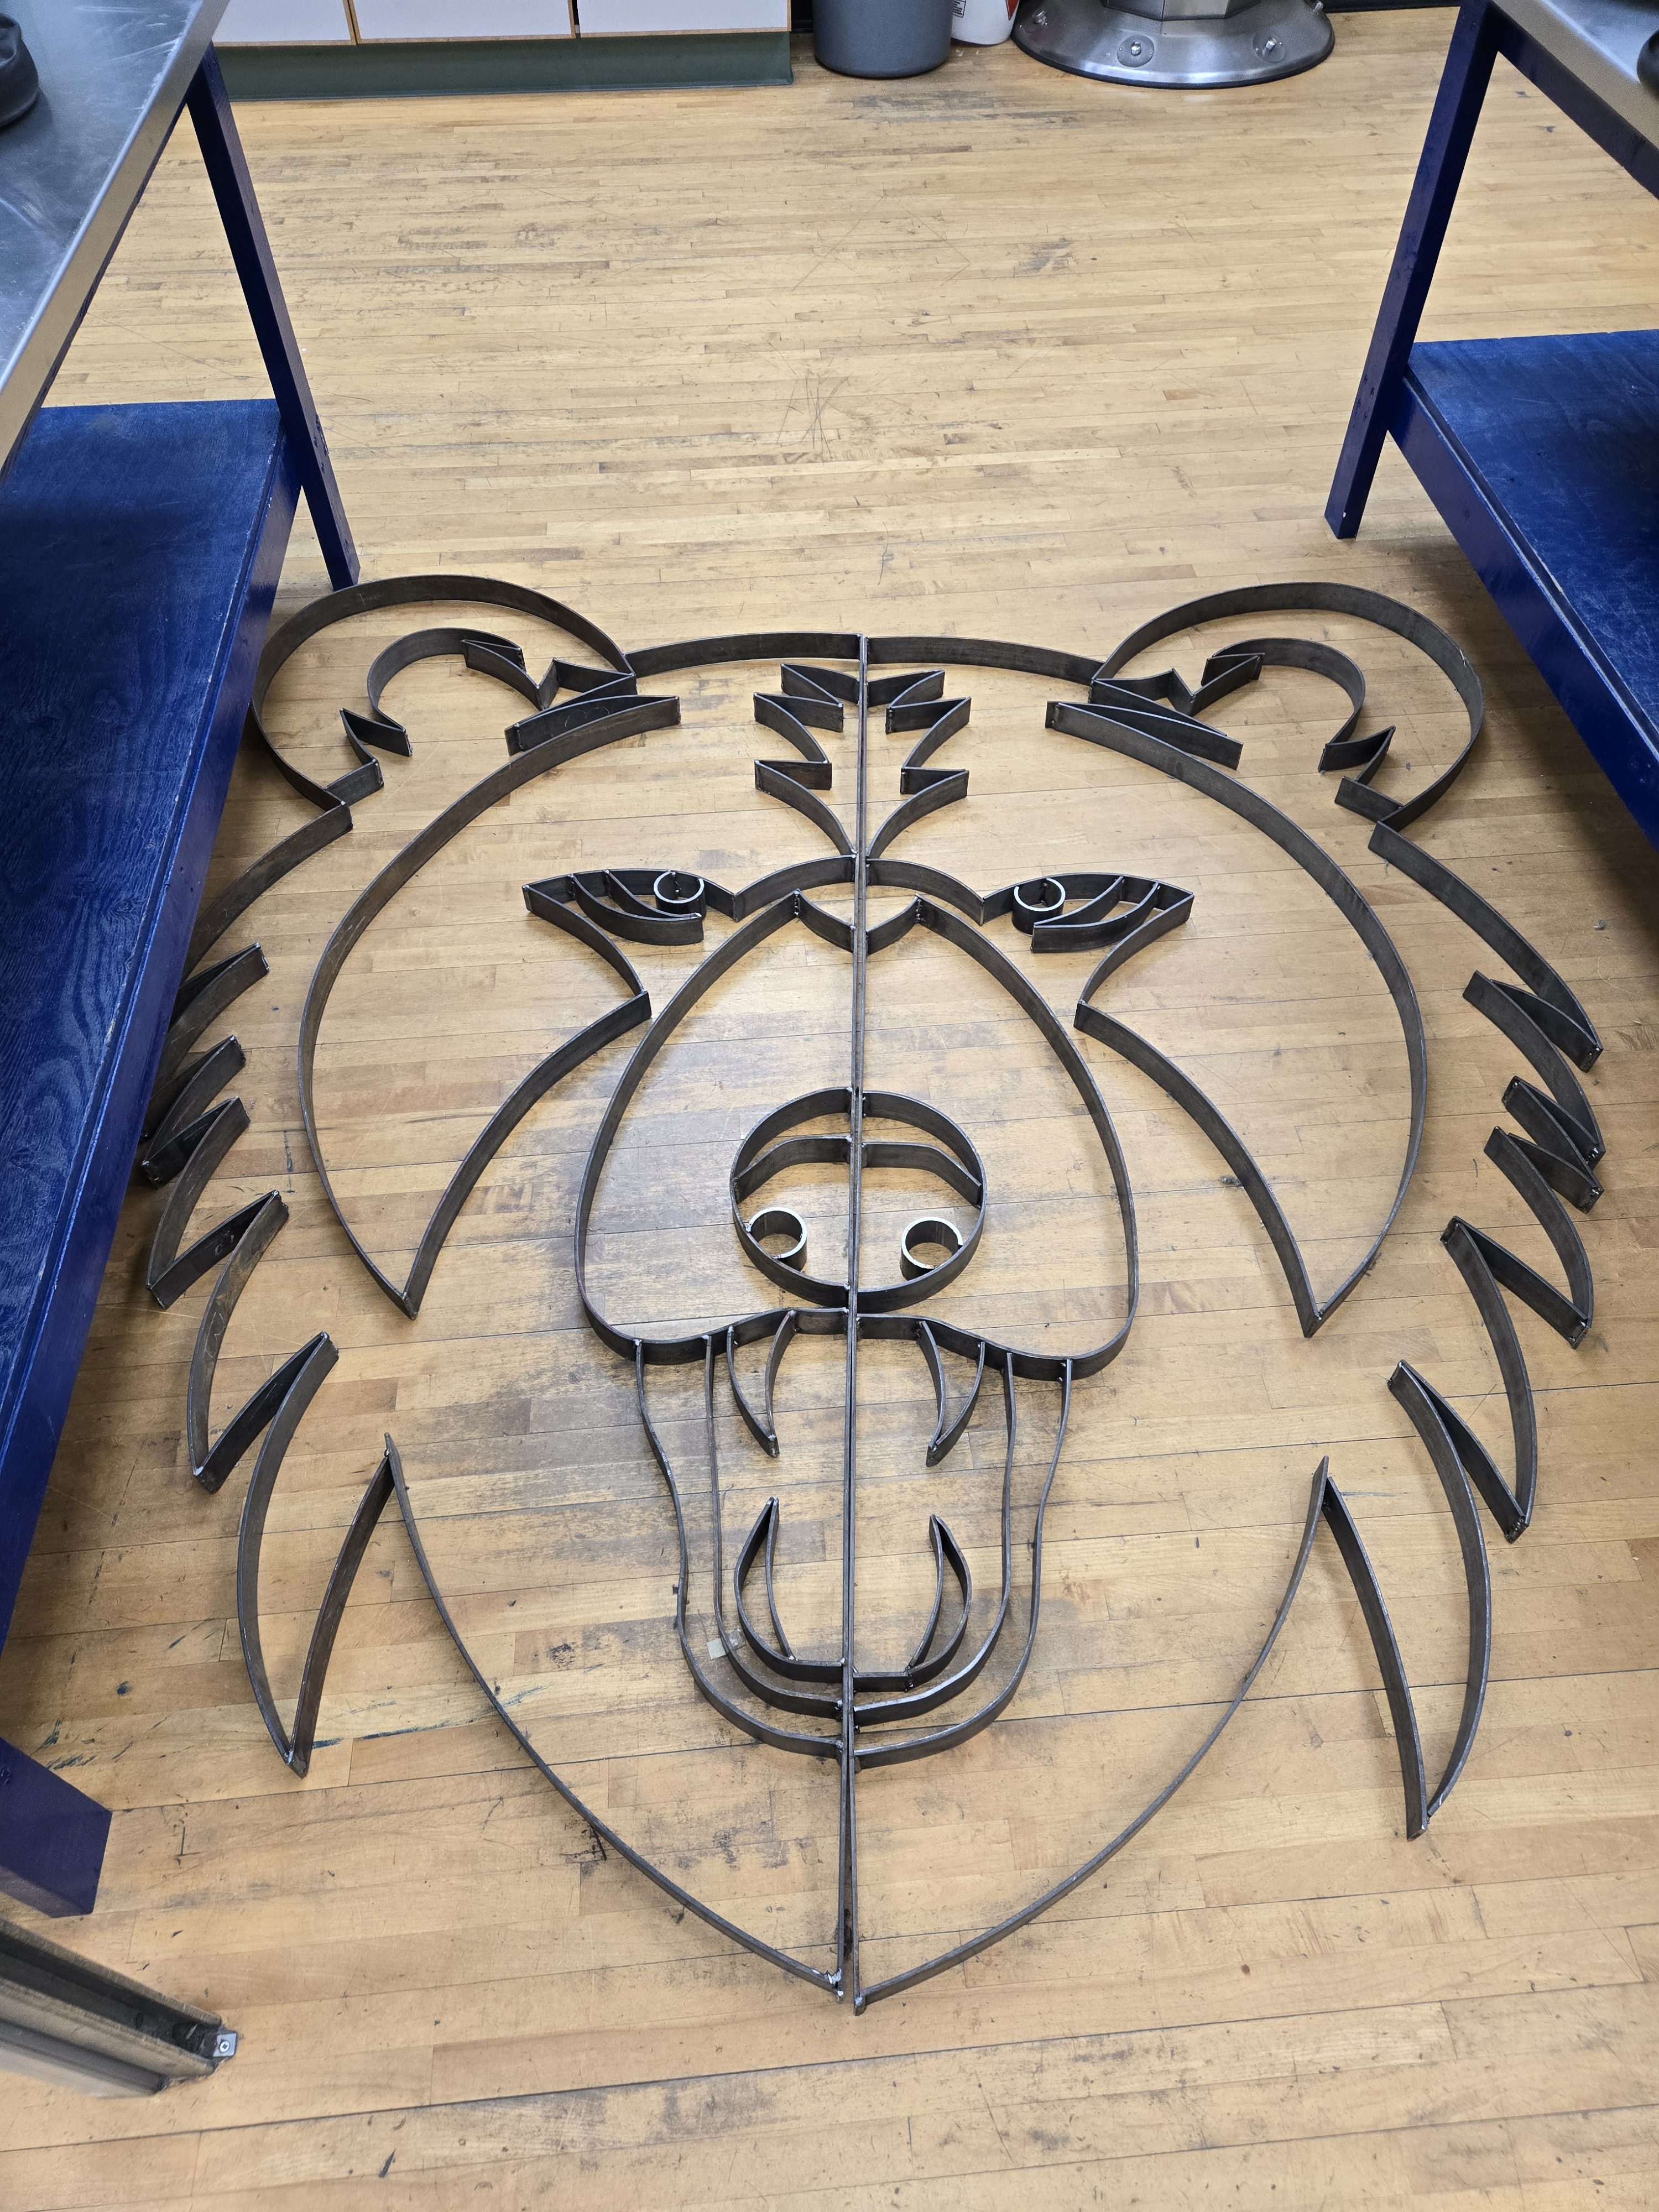
ADST
Art Metal Jewelry
Drafting
Culinary Arts
Media Arts & Design
Metalwork
Mountain Biking
Power Technology (Auto Shop)
Textiles
Woodwork

Slide 16
LVR Academies – applications required
LVR Dance
Includes an intensive academy course at LV Rogers Secondary integrates advanced technique classes in ballet and modern dance technique. Technique classes will be intensive and will focus on alignment, strength, flexibility, use of breath and musicality primarily through ballet and contemporary dance technique
ATLAS
Is an exciting career prep program for grade 12 students who have a strong personal interest in adventure recreation. This course will introduce students to the technical skills required for a variety of adventure-based industries. This opportunity will facilitate students to develop their “outdoor skills resume”, a requirement for many adventure tourism post-secondary programs.
Basketball
With a focus on practical and authentic experiences, students will hone their skills, coach and referee younger players and manage school tournaments. This course includes the teaching and practice of fundamental skills, offensive and defensive strategies, and positional play used at all levels of basketball.
Volleyball
The Volleyball Academy course provides a unique setting for students who are keen to improve their fundamental skills, learn offensive and defensive schemes and their overall understanding of the game of volleyball.

Slide 17
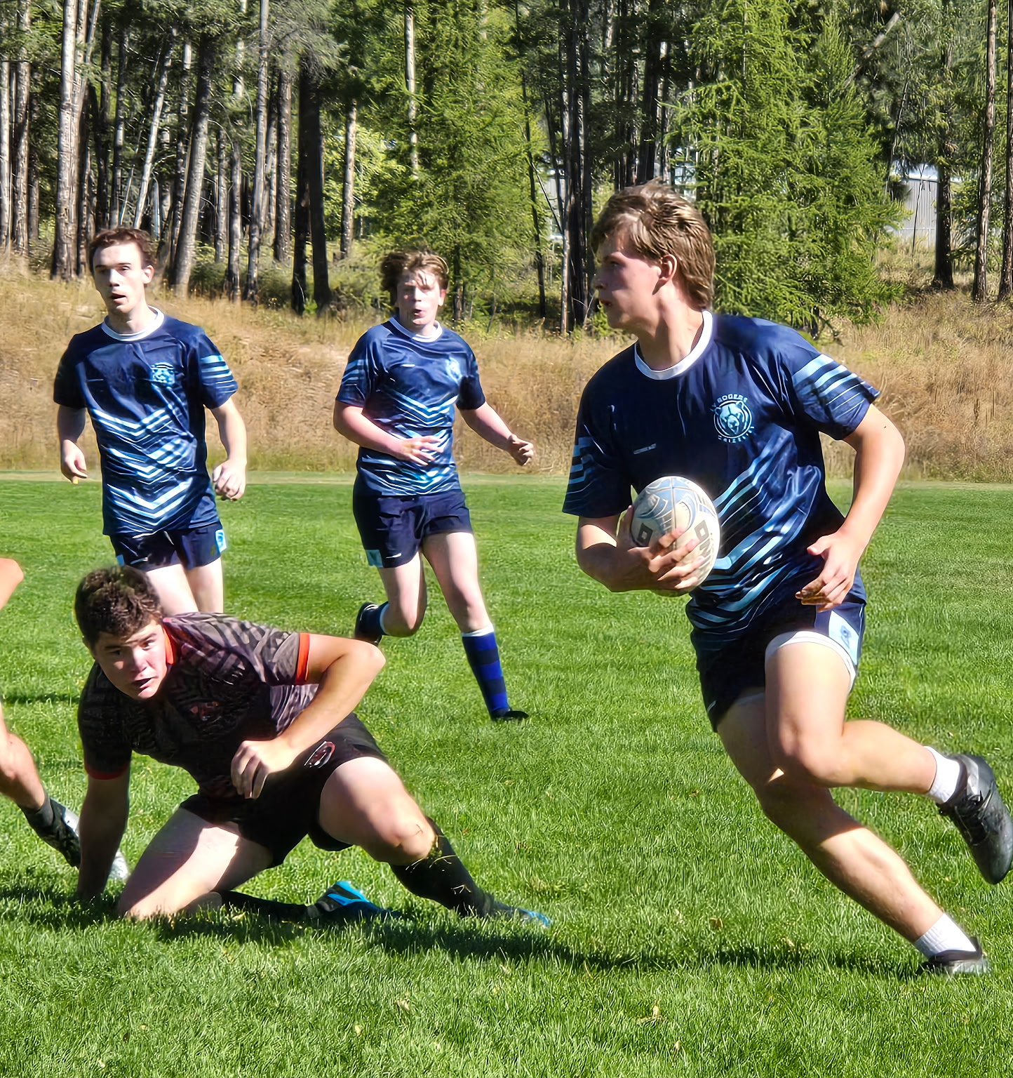
Clubs, Teams, and all the other good stuff
https://lvr.sd8.bc.ca/programs/athletics/lvr
Athletics, Green Team, Clubs, etc. etc.,
High school at LV is all about finding your passion and putting yourself out there.

Slide 18
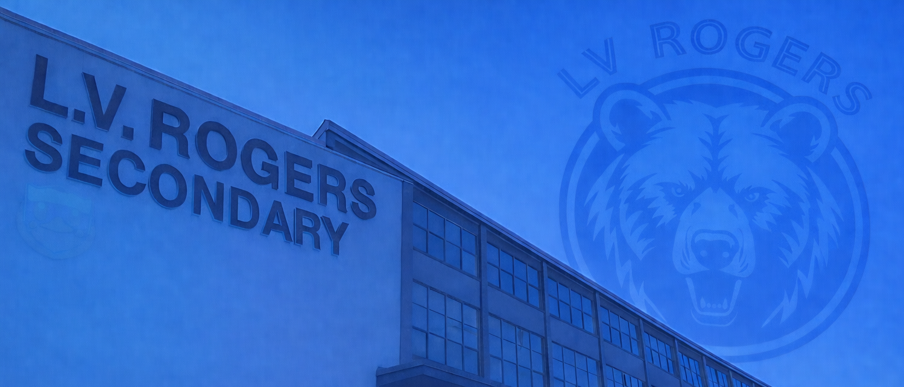
Course Selection
What do I actually have to do?

Slide 19
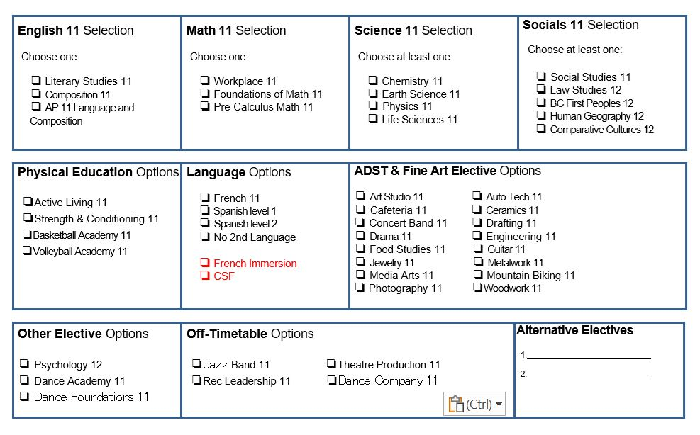

Slide 20
Course Request Timelines
Grade-wide meetings
Wednesday, March 4th
Course requests
Week of March 9 -13th
Follow up / catch ups
First week back during lunchtime

Slide 21
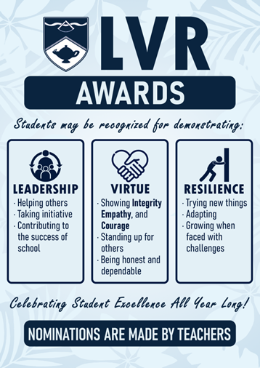
Awards and Recognitions
At LV Rogers, we celebrate achievement, but we also recognize contribution, character, and growth.
The L.V.R. Awards recognize students who contribute to our school community through their Leadership, Virtue (Integrity, Empathy and Courage), or Resilience. The LVR Awards are nominated by staff and handed out at the end of each semester.
Academic Honour Roll celebrates Grade 11 students with at least 7 classes scheduled at LVR and who achieve an average of 86% and above for the school year. Academic Honour roll is awarded at the end of the school year.

Slide 22
Final words of advice
Don’t just choose what feels easiest, choose what helps you grow.
Try something new, commit to the work, and stay with challenges when they get hard.
Those are the experiences that shape who you will become. They are what will help you make the most of your time at LVR

Slide 23
Where can I find more information?
LVR homepage
LVR Course selection
3 year grad plan
Post-Secondary Planner

Slide 24
Questions?
Thank you!
Ian Cooper - Principal
ian.cooper@sd8.bc.ca
LVR Weekly Blog
https://lvr.sd8.bc.ca/blog
Roman Wyllie – Vice Principal
roman.wyllie@sd8.bc.ca
Cara McGuire –
Gr. 10 - 11 Counselor
cara.mcguire@sd8.bc.ca

