Slide 1

LV Rogers
Course Selection Presentation
2026 - 2027
Grade 11 going into Grade 12

Slide 2

Land Acknowledgement
I gratefully acknowledge, respect and honour the First Nations in whose traditional territories the Kootenay Lake School District operates and all Aboriginal people residing within the boundaries of School District #8.

Slide 3
Required Courses for Grade 12 – English Program
All Grade 12 students will be pre-enrolled in English Studies 12 and Career Life Connections (CLC). These are courses that are required for graduation. Additional English courses are available as elective options

Slide 4
Required Courses for Grade 12
French Immersion Program
All Grade 12 French Immersion students will be pre-enrolled in Français langue seconde - immersion 12 (FRAL 12) in addition to English Studies 12 and Career Life Connections (CLC)

Slide 5
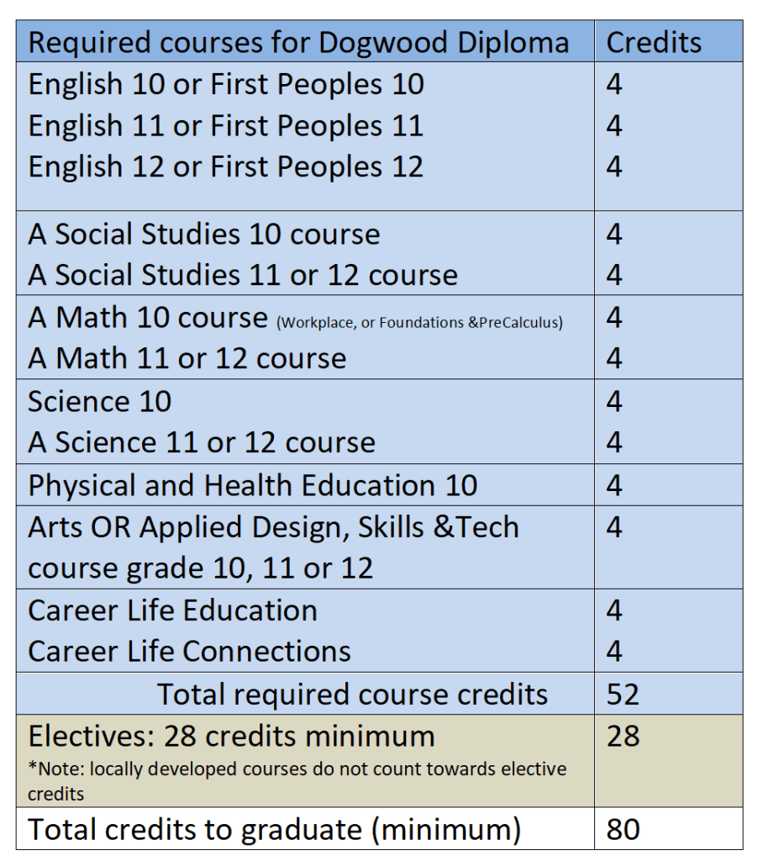
Requirements for Graduation
Important notes about credits:
Of the 80 credits required to graduate, a minimum of 16 credits must be for courses at the Grade 12 level (generally 4 courses)
At least 4 credits must be from Indigenous-focused course work.
In addition to the 80 credits students must complete three Provincial Assessments:
· Literacy 10
· Numeracy 10
· Literacy 12

Slide 6
Grade 12 Math options
Pre-Calculus 12
Calculus 12
Foundations & Pre-calculus Math 12
Or another Math course at the Grade 11 Level

Slide 7
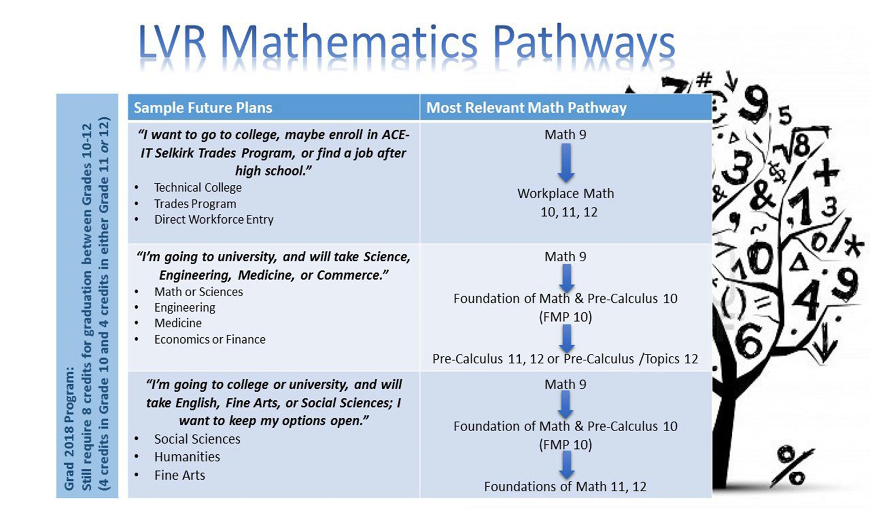

Slide 8
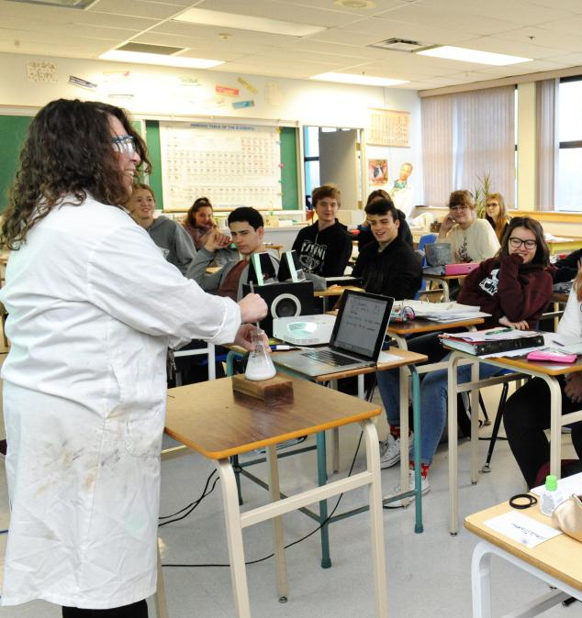
Grade 12 Science -
Discover your interests
Chemistry 12
Physics 12
Life Sciences 12
Or another Science course at the Grade 11 Level
PSI may require two Science 12 courses

Slide 9
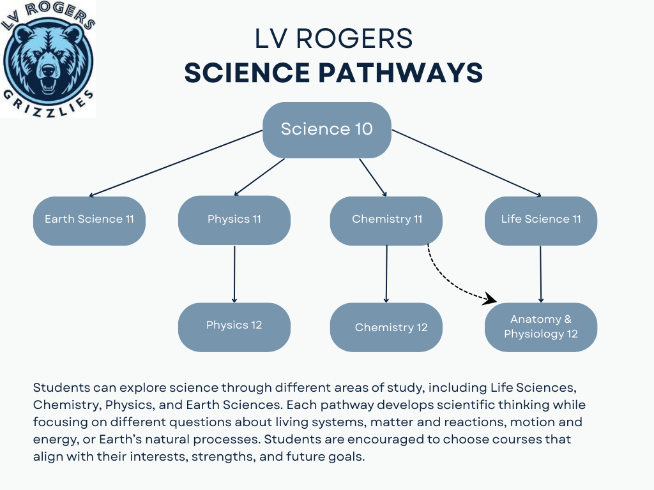

Slide 10
Grade 12 Electives:
Students in Grade 12 can fill their schedules (after their required courses) with so many options.
This could be anything from additional academic or elective courses, Grade 11 classes or many others
Electives are often where students discover strengths they didn’t know they had.

Slide 11

Fine Arts
Visual Arts
Art Studio
Ceramics
Photography
Drama
Drama
inside the timetable
Theatre Production outside the timetable

Slide 12
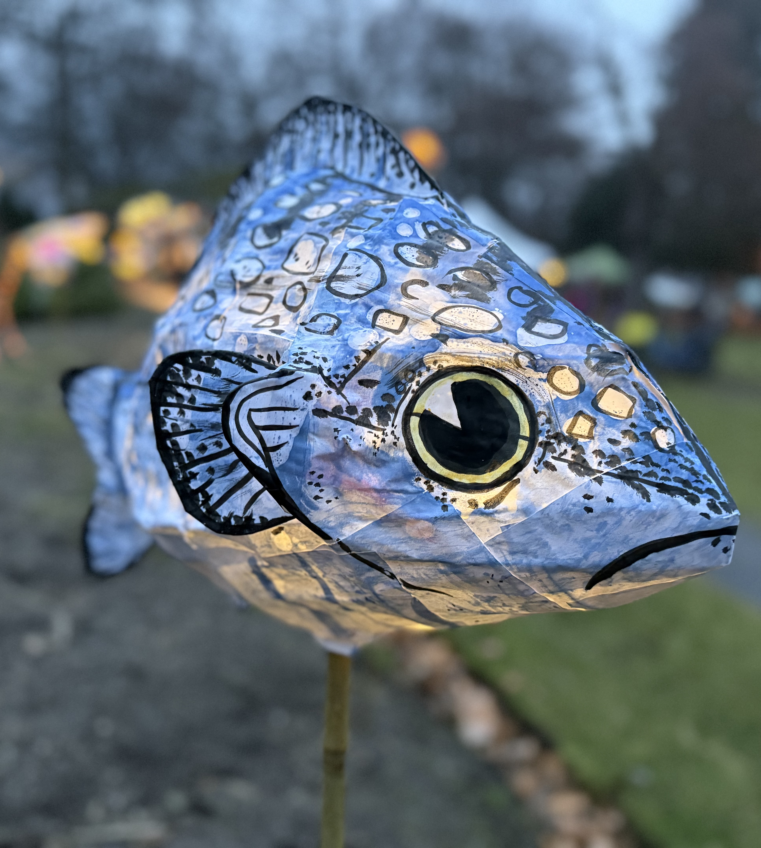
Even more Fine Arts
Music
Concert Band inside the timetable
Jazz Band outside the timetable
Guitar inside the timetable
Dance
Dance Academy (full year, two courses) inside the timetable
Dance Company (full year, one course) outside the timetable
Dance Foundations (One semester, one course) inside the timetable
Notes:
If jazz band, then sign up for in timetable Concert band as well. Possible Jr. and Sr. Bands as well depending on numbers

Slide 13
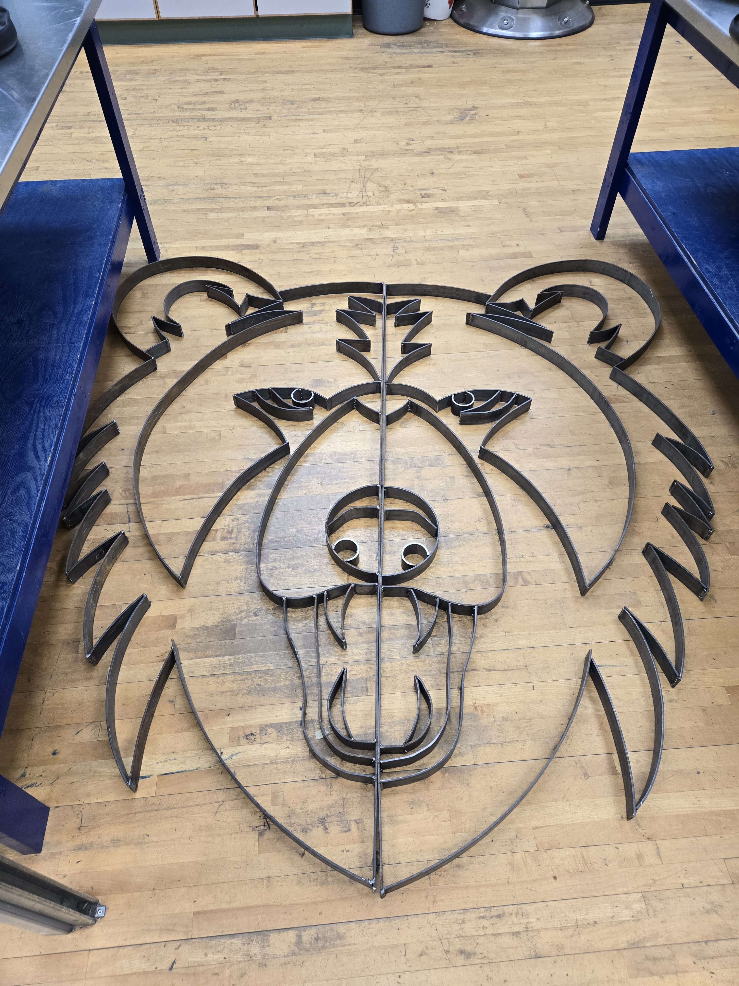
ADST
Art Metal Jewelry
Drafting
Culinary Arts
Media Arts & Design
Metalwork
Mountain Biking
Power Technology (Auto Shop)
Textiles
Woodwork

Slide 14
LVR Academies – applications required
LVR Dance
Includes an intensive academy course at LV Rogers Secondary integrates advanced technique classes in ballet and modern dance technique. Technique classes will be intensive and will focus on alignment, strength, flexibility, use of breath and musicality primarily through ballet and contemporary dance technique
ATLAS
Is an exciting career prep program for grade 12 students who have a strong personal interest in adventure recreation. This course will introduce students to the technical skills required for a variety of adventure-based industries. This opportunity will facilitate students to develop their “outdoor skills resume”, a requirement for many adventure tourism post-secondary programs.
Basketball
With a focus on practical and authentic experiences, students will hone their skills, coach and referee younger players and manage school tournaments. This course includes the teaching and practice of fundamental skills, offensive and defensive strategies, and positional play used at all levels of basketball.
Volleyball
The Volleyball Academy course provides a unique setting for students who are keen to improve their fundamental skills, learn offensive and defensive schemes and their overall understanding of the game of volleyball.

Slide 15
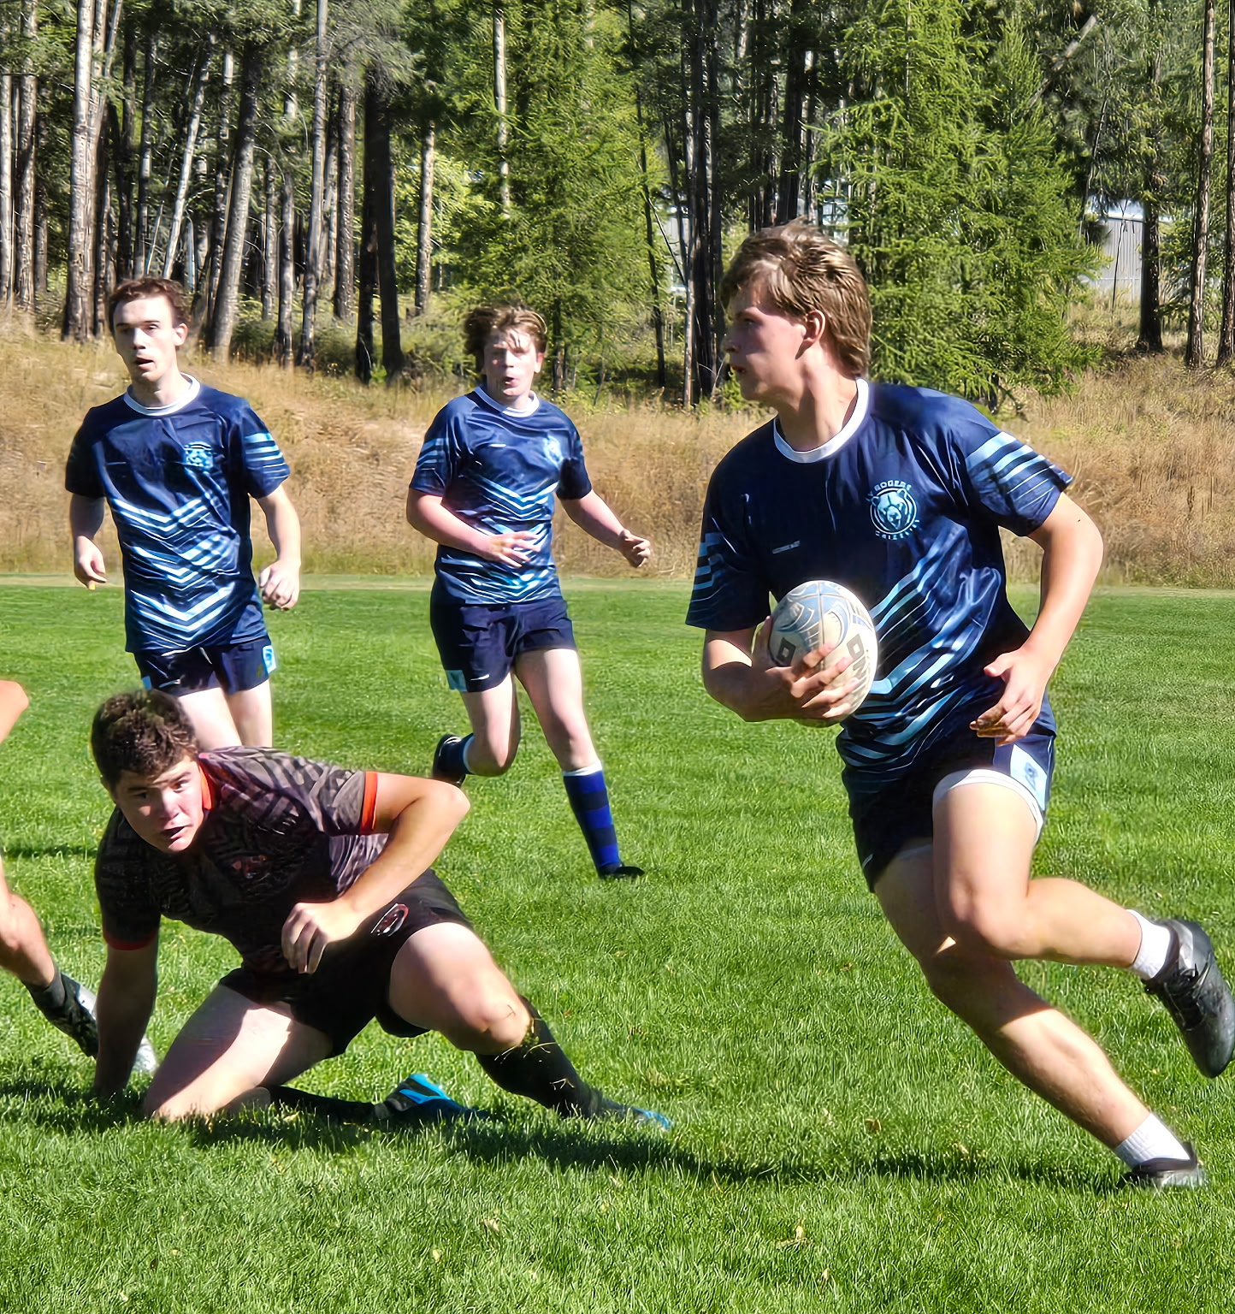
Clubs, Teams, and all the other good stuff
https://lvr.sd8.bc.ca/programs/athletics/lvr
Athletics, Green Team, Clubs, etc. etc.,
High school at LV is all about finding your passion and putting yourself out there.

Slide 16
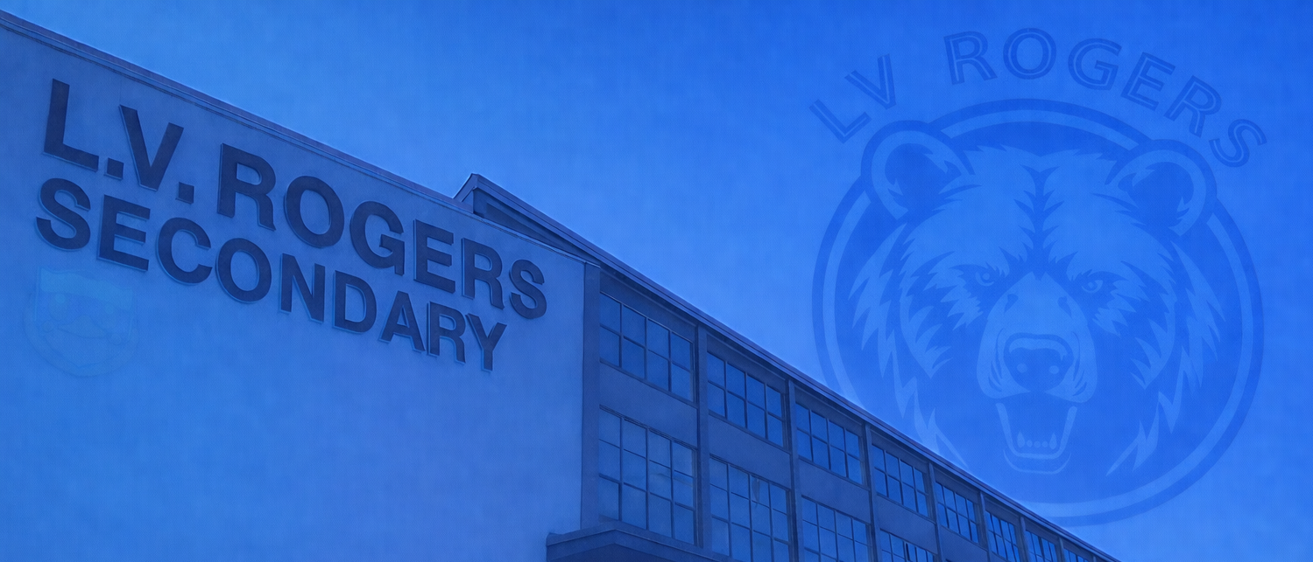
Course Requests
What do I actually have to do?

Slide 17
Course Request Timelines
Grade-wide meetings
Wednesday, March 4th
Course requests
Week of March 9 -13th
Follow up / catch ups
First week back during lunchtime

Slide 18
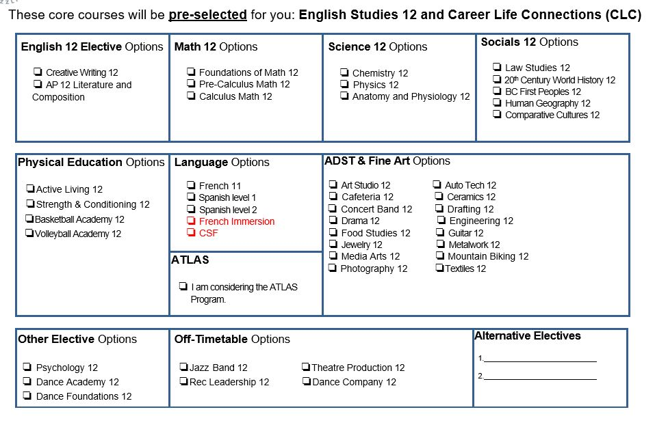

Slide 19
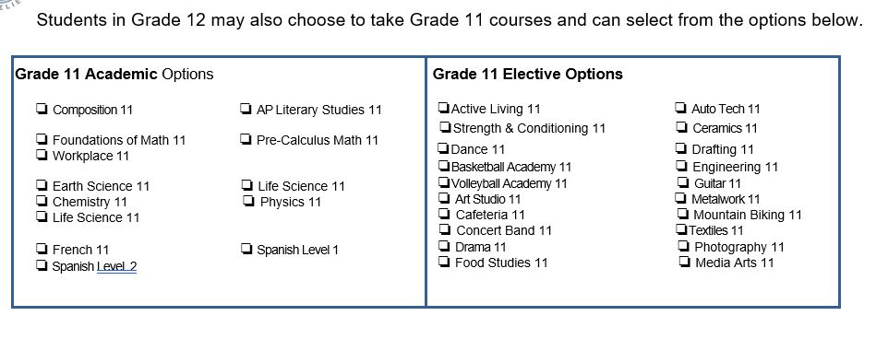
We encourage students to request a full schedule with LVR. This includes students planning to do YTT or ATLAS. It is easier to withdrawal than add last minute. Some scholarships and awards also require students to be full-time.

Slide 20
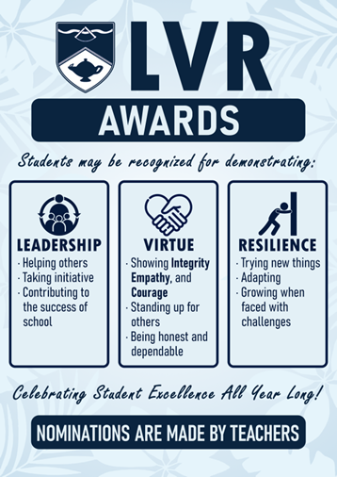
Awards and Recognitions
At LV Rogers, we celebrate achievement, but we also recognize contribution, character, and growth.
The L.V.R. Awards recognize students who contribute to our school community through their Leadership, Virtue (Integrity, Empathy and Courage), or Resilience. The LVR Awards are nominated by staff and handed out at the end of each semester.
Academic Honour Roll celebrates Grade 12 students with at least 6 classes scheduled at LVR and who achieve an average of 86% and above for the school year. Academic Honour roll is awarded at the end of the school year.

Slide 21
Final words of advice
Don’t just choose what feels easiest, choose what helps you grow.
Try something new, commit to the work, and stay with challenges when they get hard.
Those are the experiences that shape who you will become. They are what will help you make the most of your time at LVR

Slide 22
Where can I find more information?
LVR homepage
LVR Course selection
3 year grad plan
Post-Secondary Planner

Slide 23
Questions?
Thank you!
Ian Cooper - Principal
ian.cooper@sd8.bc.ca
LVR Weekly Blog
https://lvr.sd8.bc.ca/blog
Roman Wyllie – Vice Principal
roman.wyllie@sd8.bc.ca
Miranda Terlingen –
Gr. 12 Counselor
Miranda.Terlingen@sd8.bc.ca

